Slide 1
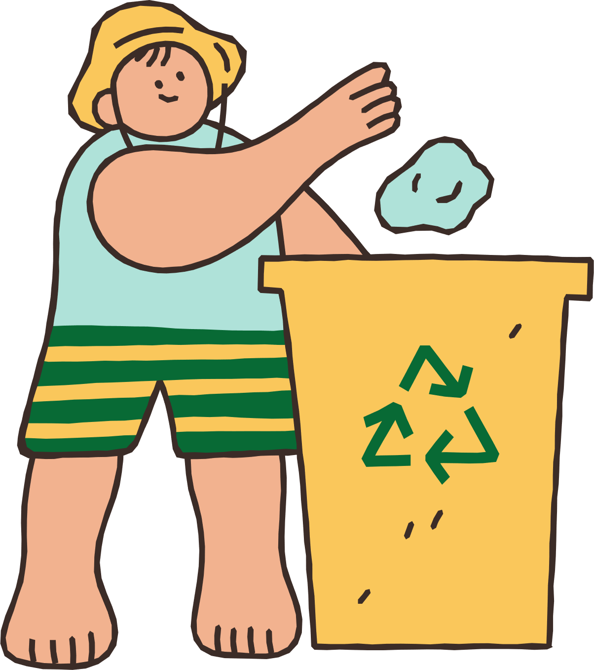
RecycLink: Smart Waste-to-Energy and E-Waste Recovery Hubs
NatureNinjas
Jaidev M V
jaidev2006murali@gmail.com

Slide 2

PROBLEM STATEMENT
In today’s rapidly urbanizing world, the growing amounts of organic waste, plastic waste, and e-waste are creating severe environmental challenges.
Poor segregation at source, inefficient collection, and reliance on overflowing landfills lead to soil, air, and water pollution, and contribute significantly to greenhouse gas emissions.
Existing smart waste solutions often focus only on collection or sorting but fail to integrate waste-to-resource conversion, clean energy generation, or community participation, resulting in limited real impact.

Slide 3

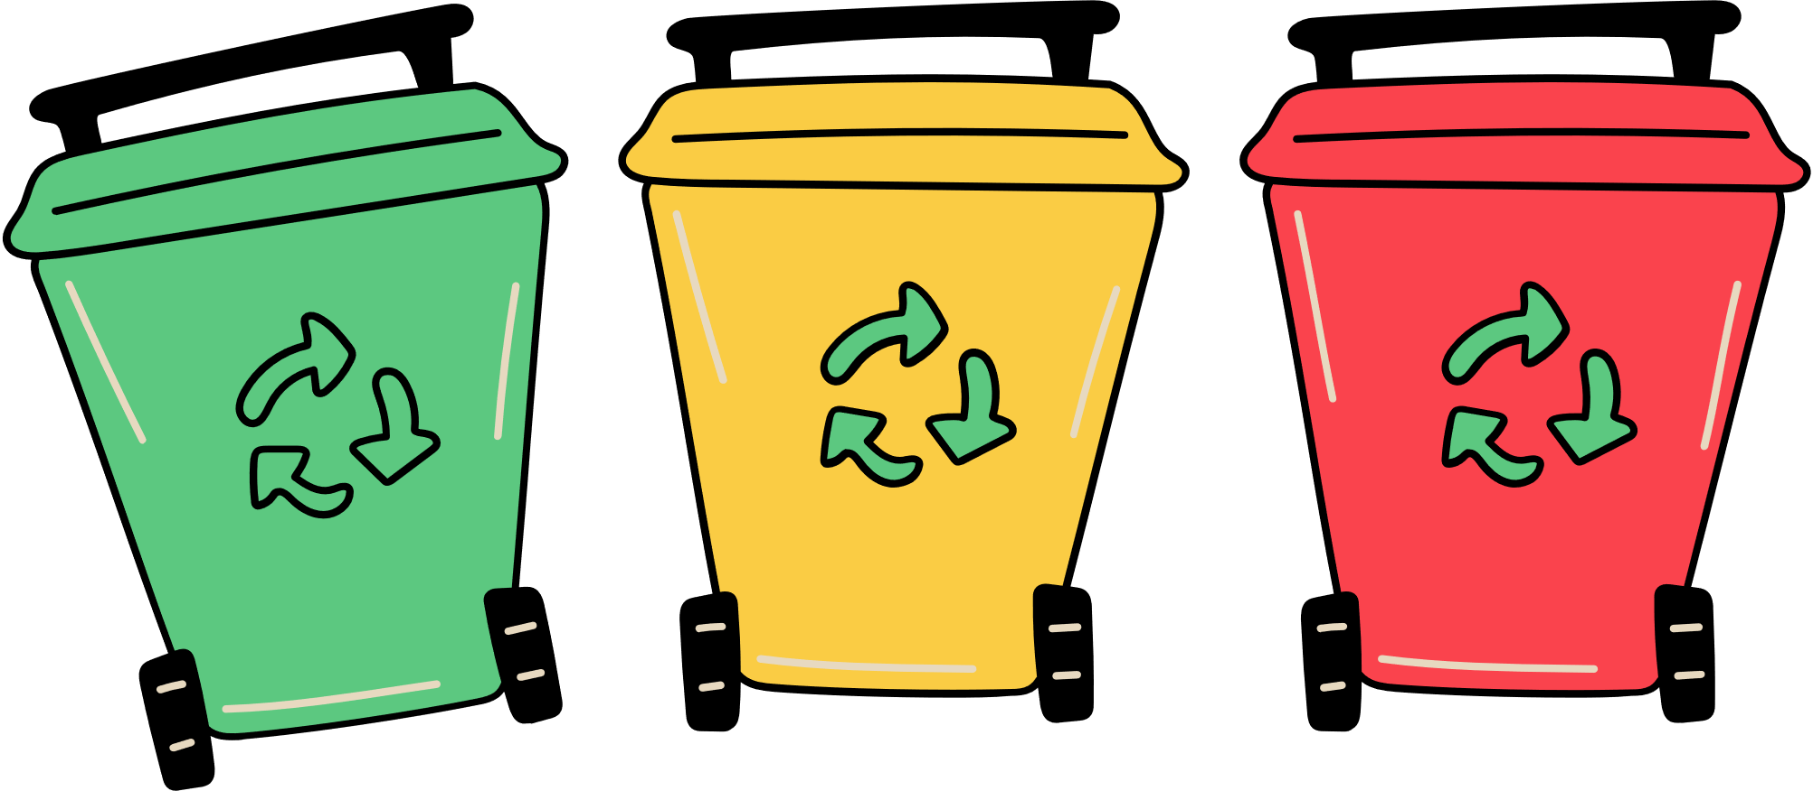
WHY RECYCLINK?
Rapid industrialization and digital growth have created massive amounts of unmanaged waste.
Plastic, organic waste, and e-waste are filling up landfills and polluting soil, air, and water.
Most communities lack smart, decentralized systems to turn waste into valuable resources.
Climate change impact is rising due to poor waste management and greenhouse gas emissions.

Slide 4
OUR SMART, INTEGRATED SOLUTION
Smart IoT bins automatically detect, sort, and monitor waste.
Organic waste is turned into biogas for clean energy and compost for local gardens.
Plastic waste is compressed into eco-bricks for construction.
E-waste is safely processed to extract valuable metals.
The entire hub is powered by solar energy and tracked with a real-time community dashboard.
Communities earn green rewards for responsible waste disposal.

Slide 5
📚
LITERATURE REVIEW
1. Conventional Waste Management
Studies show that most urban and rural communities rely on manual
collection and landfill disposal, which leads to:
Low segregation rates at source (less than 30% in India’s major cities — CPCB, 2021)
E-waste often ends up mixed with municipal waste, polluting soil and water
2. Smart Bins & IoT in Waste Management
Research highlights how IoT-enabled smart bins help track fill levels and
optimize collection routes (Patil et al., 2020; IEEE Xplore). However:
These systems often stop at collection; they do not integrate waste processing, recycling, or resource recovery.
There is limited impact on community engagement or behavioral change.

Slide 6
📚
LITERATURE REVIEW
3. Automated Waste Segregation
AI-powered image recognition and robotic arms can significantly
improve segregation accuracy (Li et al., 2021; Waste Management
Journal).
Challenges include:
High initial costs for robotics hardware
Focus only on sorting, not on creating usable outputs like biogas or eco-bricks.
4. Waste-to-Energy & Bio-digesters
Small-scale bio-digesters are effective in converting organic waste to
biogas (Sharma et al., 2022, Renewable Energy).
But without smart monitoring, they can be inefficient.
Plastic waste often remains untreated.

Slide 7

RECYCLINK SYSTEM FLOW
Step 1: Households use smart IoT bins for waste segregation.
Step 2: Collected waste goes to the local processing hub.

Slide 8

RECYCLINK SYSTEM FLOW
Step 3:
Organic waste → Bio-digester → Biogas + Compost
Plastic waste → Eco-brick press → Building materials
E-waste → Recovery unit → Valuable metals

Slide 9
RECYCLINK SYSTEM FLOW
Step 4: Powered by solar energy → clean operations.
Step 5: Community dashboard tracks impact and rewards participants.
[Households] → [Smart Bins] → [Processing Hub]
→ [Bio-digester / Eco-Bricks / E-Waste Recovery]
→ [Clean Energy + Reusable Resources]
→ [Dashboard & Rewards] → [Community]

Slide 10


WHY WE STAND OUT
✅Smart integration of IoT, AI, and clean energy.
✅Handles multiple waste streams in one system.
✅Generates clean energy locally from organic waste.
✅Rewards community participation and tracks real impact.
✅ Modular, scalable, and replicable for any community.

Slide 11
Comparative Table: Why RecycLink is the Best
a
Aspect | Conventional | Smart Bin Only | AI Waste Segregation | Waste-to-Energy Only | RecycLink
Segregation Accuracy | Low | Medium | High | Low | High
Handles Multiple Waste Streams | No | No | No | Sometimes | Yes
Generates Clean Energy | No | No | No | Yes | Yes
Converts Plastic Waste | No | No | No | No | Yes
Safe E-Waste Recovery | No | No | No | No | Yes
Community Engagement | No | Low | Low | Low | High
Scalable & Modular | Low | Medium | Medium | Medium | High
“RecycLink is the only solution that combines smart tech, energy generation, and community empowerment in one integrated system.”

Slide 12
REAL IMPACT FOR PEOPLE & PLANET
Diverts waste away from landfills, reducing pollution.
Generates clean, local energy and compost for communities.
Produces eco-bricks for affordable housing or infrastructure.
Prevents hazardous e-waste from polluting land and water.
Creates local green jobs and supports the circular economy.
Empowers communities to achieve zero-waste, energy-positive living.

Slide 13
SCALABILITY & FUTURE VISION
Launch a pilot hub in one community or campus.
Partner with local governments, NGOs, and waste pickers.
Develop and release the community rewards app.
Expand to more schools, neighborhoods, and industries.
Build self-sustaining, zero-waste, energy-positive communities across regions.

Slide 14
LET’S INNOVATE FOR NATURE!
“With RecycLink, we transform waste into a valuable resource, engage communities, and protect Mother Nature for future generations.”

Slide 15
LET’S INNOVATE FOR NATURE!
“With RecycLink, we don’t just manage waste — we convert it into clean energy and resources, close the loop on multiple waste streams, and drive real community action. That’s how we restore, preserve, and protect Mother Nature.”

Slide 16


THANK YOU
NatureNinjas
Jaidev M V
jaidev2006murali@gmail.com

